Slide 1
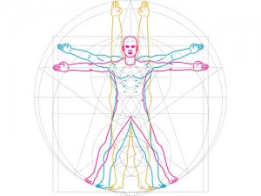
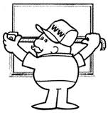
Quantitation
Morphological Research Methods
Sampling
Morphometry
Stereology
Pattern Analysis
Image Analysis
ACA4 (2020) - Mike Mahon School of Medicine, Faculty of Medicine & Health Sciences

Slide 2
Questions
Why measure ?
What do you want to measure ?
How do we measure ?
Are the results unbiased, precise, accurate, valid, meaningful ?

Slide 3
Questions
Why measure ?
What do you want to measure ?
How do we measure ?
Are the results unbiased, precise, accurate, valid, meaningful ?

Slide 4
Why measure ?
“ …. When you can measure what you are speaking about and express it in numbers, you know something about it; but when you cannot express it in numbers, your knowledge is of a meagre and unsatisfactory kind; it may be the beginning of knowledge, but you have scarcely in your thoughts advanced to the state of Science, whatever the matter may be.” Lord Kelvin (1883)

Slide 5
Why measure ?
Obtain Absolute Data
Variability / Constancy
Relative / Comparative Data
Experimental v Control Data
Disease v Healthy Data
Treatment v Control Data
Data on Changes / Growth / Ageing / Differences
Data on Structure / Function Relationships
Data to Predict / Mathematical Models
“The plural of anecdote is not data !”

Slide 6
Why measure ?
What do you want to measure ?
How do we measure ?
Are the results unbiased, precise, accurate, valid, meaningful ?

Slide 7
Things which may be measured
What ?
Structures (3D)
Number, size, surface area, length, volume, shape, …
Mass
Weights of organelles, cells, tissues, organs, people, ...
Shapes & Arrangement
Macromolecules, organelles, cells, tissues, organs, people, …
Chemical Constituents
Storage products, DNA
Activity – Time (4D)
Enzyme activities, intracellular events, cell turnover, movement

Slide 8
What to Measure
What ?
Whole Body
Height, Weight, Girths, Composition, Anthropometry, Somatotype, Auxometry
Whole organ
Volume: Water displacement, Specific Gravity, Hydrostatic weighing
Size
Lengths, Widths
Amount
Lengths, Lv; Surface areas, Sv; Volumes, Vv
Numbers
NA, Nv, N
Shapes
Roundedness, Indentedness, S:V ratios, Form Factors
Orientations
Angles, Isotropic, Anisotropic, Branching
Locations & Patterns
Random, Clumped, Dispersed, Related

Slide 9
Examples
What ?
Proportion of muscle, fat, bone, skin in limb
Size of muscle fibres, Haversion systems, glomeruli …
Number of neurons in the brain/ spinal cord/ DRG
Number of fibrocytes per unit of tendon
Length of capillary network in ligament
Amount of lipid in heart
Surface area of villi in gut, alveoli in lung
Orientation/branching of Purkinje fibres in cerebellum
Relationship of necrotic cells to capillaries
Angle of pennation in muscles

Slide 10
Applications
What ?
Anatomy, Neuroanatomy, Embryology
Histology, Histochemistry, Autoradiography, …
Pathology
Radiology
Food Science
Metallurgy
Materials Science
Geology
Ecology
Geography
Social Sciences
Astronomy

Slide 11
Why measure ?
What do you want to measure ?
How do we measure ?
Are the results unbiased, precise, accurate, valid, meaningful ?

Slide 12
How ?
“ One ounce of thought is worth one ton of equipment.” Lord Rutherford

Slide 13
Pre-Quantitation
How ?
Qualitative Analysis
Observation / Visualisation / Form / Organisation
Recording
2D/3D Interpretation / Serial:Thick Sections / Reconstruction
Functional Interpretation
Subjective Quantification
Variability
Amount, many, more, larger, ++++
Activity
Relate to other levels of organisation, up, down
Relate to other methodologies – Physiol, Biochem, Living
Artefacts / Misunderstandings

Slide 14
2D < > 3D

Slide 15
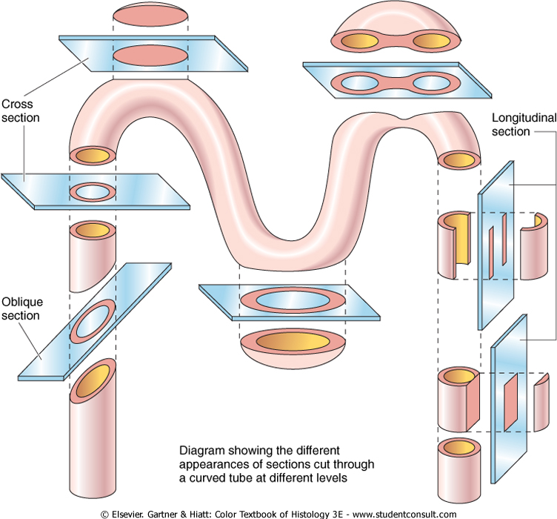
2D < > 3D

Slide 16
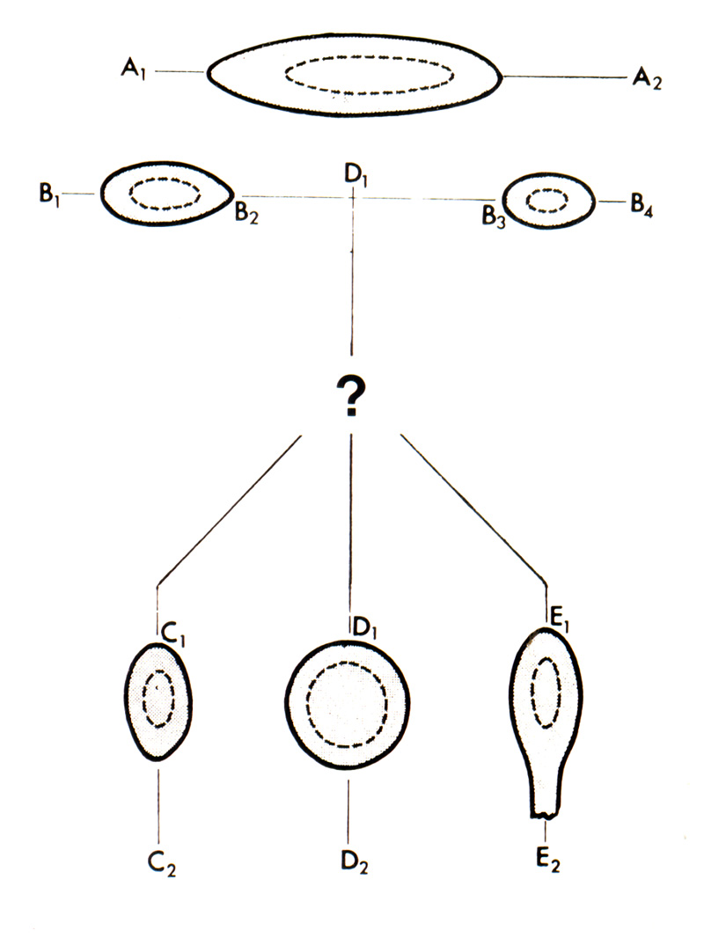
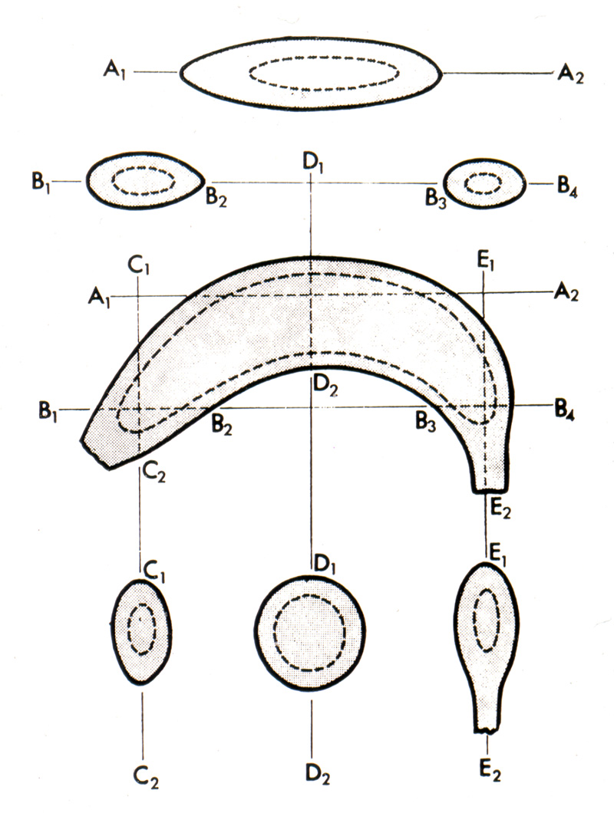
2D < > 3D

Slide 17
Quantitation
How ?
Optical Properties
Analytical Microscopy
Reflectometry, Phase Contrast/Refractometry, Polarising, Interference, ‘Weigh cells’, Microdensitometry
Semi-Quantitative
Rating scales, ++++
Geometrical Properties
Sampling
Morphometry (… directly)
Stereology (… indirectly 2D/3D)
Pattern Analysis
Image Analysis

Slide 18
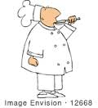
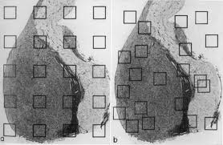
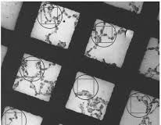
Sampling
How ?
Identify Object
Staining
Magnification
Representative
Is tissue Homogeneous (Isotropic) / Irregular (Anisotropic) Heterogeneous (Anisotropic) Gradiential (Anisotropic)
Random
Completely random
Systematic stratified random sampling
Zonal oblique sector analysis
Manual / Automated
How many samples? (Experimental Design)
Individuals / Organs / Blocks / Sections / Micrographs / Items / Measures
Hally Formula RSE= SQRT (1-Vv)/SQRT n
Progressive mean, Log Plots
Do More, Less Well !

Slide 19
Progressive Mean
Average Size μm
Data: 80, 10, 30, 40, 50, 45, 30, 35, 40, 40, ….
100
80
60
40
20
0
10
20
30
40
50
60
70
80
90
100
Number

Slide 20
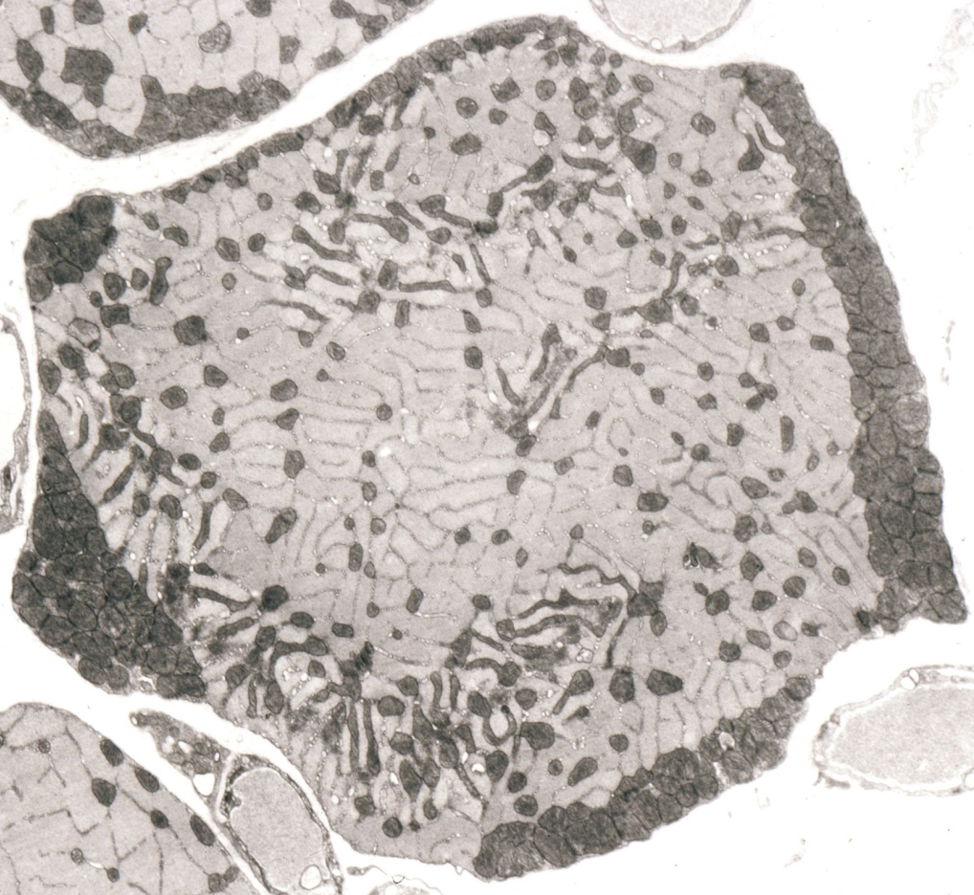
Skeletal Muscle – Random Sampling Micrographs at x18,000
Skeletal Muscle – Zonal Oblique Sector Analysis Method (ZOSAM)
x
$$√$$
Z1 Z2 Z3 Z4
Z4 Z3 Z2 Z1
Sampling: $≤1, RSE, Prog. Mean$
Mahon et al, 1973

Slide 21
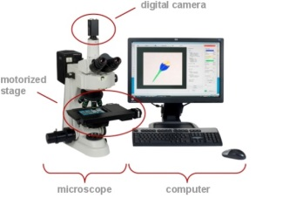
Which Method ?
How ?
Morphometry
direct measurement of structures
Stereology
extrapolation from 2D to 3D using simple counting methods
Image Analysis
combination of above using digital imaging and computers in manual or automatic modes
plus data presentation and analysis

Slide 22
Morphometry 1
How ?
Measurement of Form
Magnification calibration
Known Objects, Graticules, Beads, Crystals, Hysteresis, Axes (printing, distortion)
Section Thickness
Weigh, Calipers, Inteferometry; Holmes effect
Preparation effects
Fixation, dehydration, embedding, sectioning, staining
Equipment & Time available / Costs

Slide 23
Tissue Preparation Effects
Fixation Effects (Sissons, Goldspink, Strickland 1960s, 1970s)
Flemmings - 3-15%
Carnoys -19-36%
Bouins -23%
Formalin -23-30%
Zenker -30-40%
Length change 10%
Areal change 21%
Volume change 33%
Need a Standard ….. Ringers, Frozen, …

Slide 24
Ringer Glut Fix R OsO4 Dehydrate Epoxy Resin
100 %
90 %
80 %
70 %
60 %
Time (hrs)

Slide 25
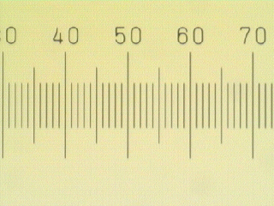
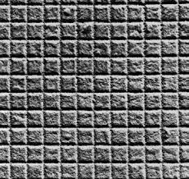
Morphometry 2
How ?
Measurement of Form
Volumes, Lengths , Surfaces , Numbers , Thickness
Diameters & Areas
Longest, shortest/narrow, Orthogonal, Feret, Average, Random chord
From area (πr²), Circle of best fit
Shape
Axial ratio, S:V ratios or Form factors(A/P², 1=4 πA/P²), Angularity (Gulfs & Peaks)
Shape of best fit (Identikit), Reconstruction
Fourier Analysis, Fractals (Mandelbrot)
Equipment
Rulers, Calipers, Graticules, Stage Micrometer, Cut & Weigh
EM: Diffraction Grating, Latex Spheres, Crystals
Filar micrometer, Image Shearing micrometer
Photographs, Drawings, Projection (Camera Lucida/Drawing Tube)
Thread, Map Measurer (Opisometer), Planimeter
Stereological lattices
Image Analyser

Slide 26
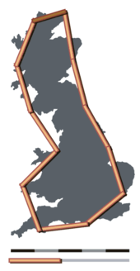
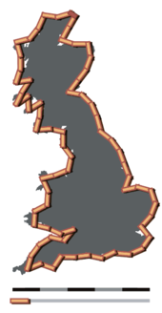
Length
Dependent on Magnification
How long is the coastline of Britain? (Mandelbrot (1967) Science)
U 200 km L 2400 km
U 50 km L 3400 km
U ?? km L 12450 km
Fractal Dimension of Wigglinesss 1.25 !

Slide 27
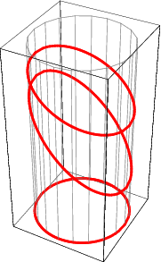
Diameter (Muscle Fibres)

Slide 28
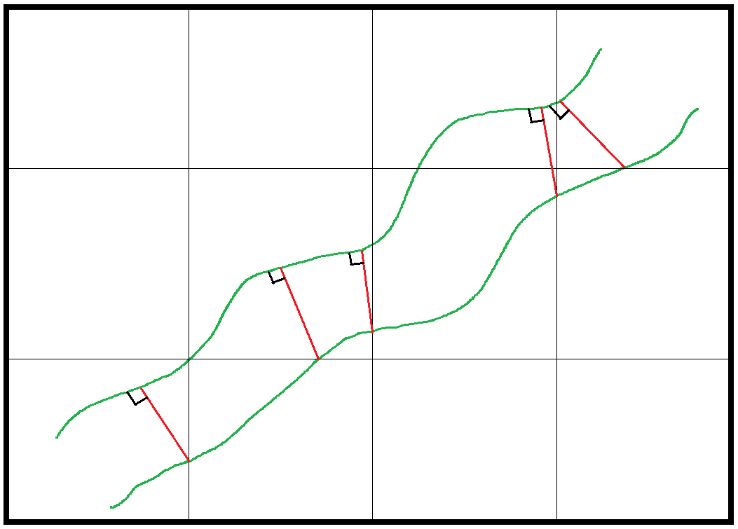
Thickness Measurements

Slide 29
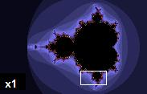
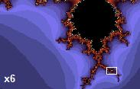
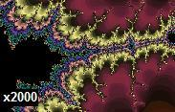
Shapes
F=(4xπxArea)/ Perimeter²
Form Factor 1.0 0.8 0.4
Gulfs 0 1 5
Fractals – Mandelbrot Set

Slide 30
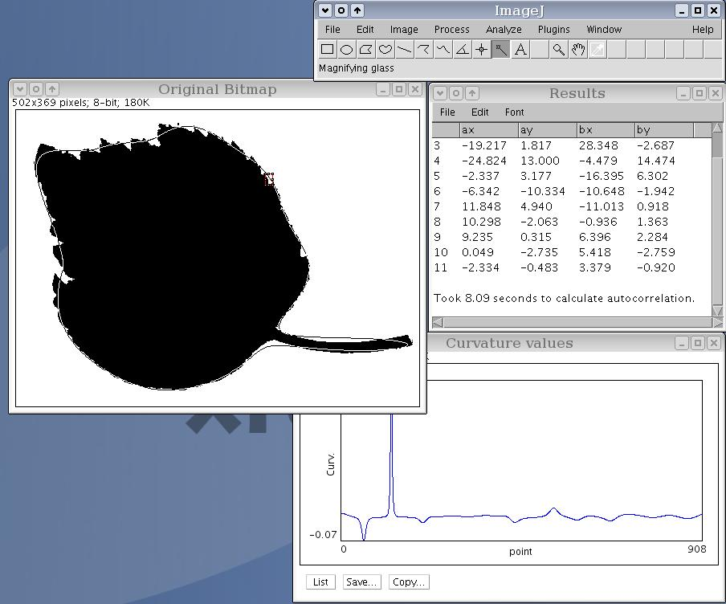
Fourier Analysis of Shape Splines

Slide 31
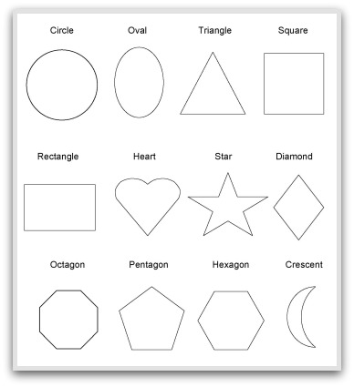
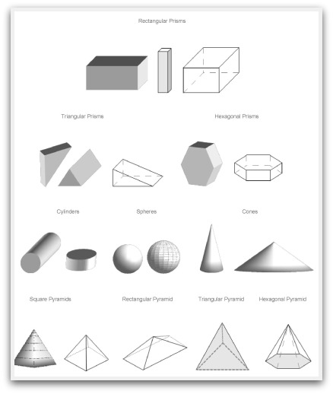
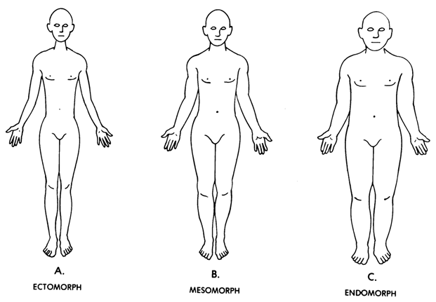
Identikit Match
Somatotypes

Slide 32
Stereology 1
How ?
Extrapolation from 2D to 3D
History
1777 Buffon
1850s Delesse, Sorby
1961 ISS, Models; Elias, Weibel, Williams, Mayhew, Cruz-Orive
1983 Unbiased/Designer: Gunderson (Cavalieri, 1635)
Dimensional Reduction
Volumes, Surface Areas, Lengths, Numbers
Volume=3D, Area=2D, Length=1D, Point=0D
Vv, Sv, Lv, Pp Point Counting, Line Cuts, Counting
Equipment
Probes (Sections, Lattices, Tally Counters, Image Analysers)
Isotropic Probes, Merz Lattices, Cycloids
Geology, Metallurgy, Biology, Engineering, Astronomy

Slide 33
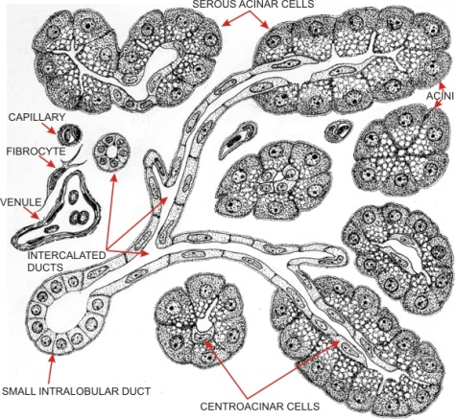
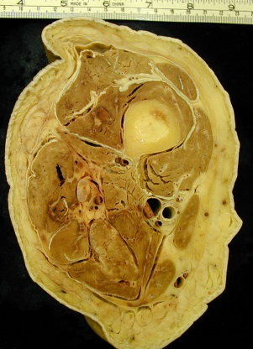
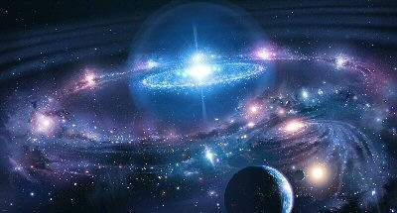
Dimensional Reduction
OBJECT SECTION
3D VOLUMES AREAS 2D
2D AREAS LENGTHS 1D
1D LENGTHS POINTS 0D
0D POINTS Hit 0D Miss X

Slide 34
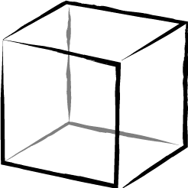
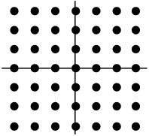
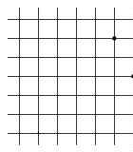
Volume Fraction
Vv
AA
LL
PP
=
=
=
Reconstruct
Planimetry Cut & Weigh Count Squares
Measure Opisometer Computer
Count

Slide 35
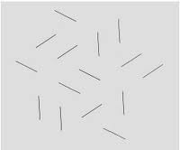
Surface Density
Sv
=
L x 4/π
A= 14 cuts
B= 5 cuts
Sv = 2 x IL
L= π /2 x IL
A
B
Buffon’s Needle (1777)

Slide 36
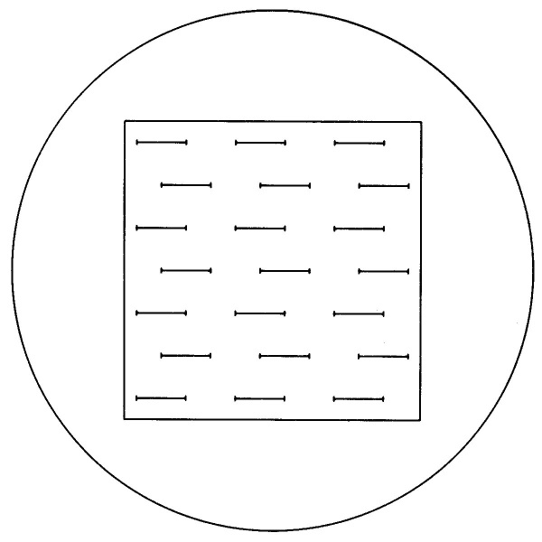
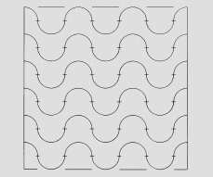
Stereology Lattices (Probes)
Use Hally formula for number of hits

Slide 37
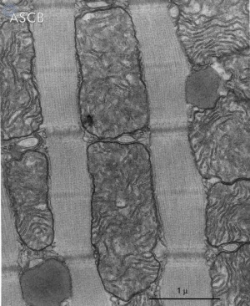
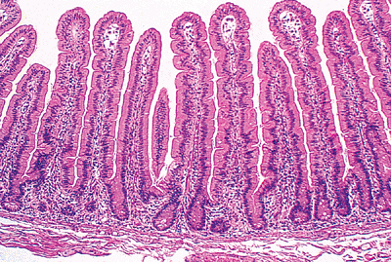
Anisotropic Tissues
ISO Sv= 2IL 2.00
Aniso 0⁰ Sv= π /2 IL 1.57
90⁰ Sv= π /√2 IL 2.22 or use line lattice at 19⁰ to L.S. or use Merz Isotropic lattice or use Linear lattice x2 & ‘measure’ orientation
Weibel, 1980
Eisenberg, 1974

Slide 38
Summary

Slide 39
Summary

Slide 40
Numbers
How ?
N, Nv, NA
Counting Objects or Profiles ?
Loose cells/smears or sections?
Depends on size and shape, section thickness
Reconstruct
Correction procedures (for Size, Shape, Populations)
Abercrombie (1946) D=dx4/ π
Schwartz-Saltykov (1958) Unfolding
Avoid: use Design Based Stereology

Slide 41
Numerical Density
Nv
NA
_
=
/D

Slide 42
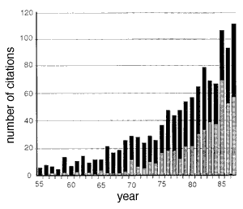
Size corrections
Monodispersed (Same Size)
13% 87%
Abercrombie (1946) Correction Factor …
D = d x 4/π (ie x1.273)
Polydispersed (Different Sizes)
Schwartz / Saltykov Unfolding
….. Shape (Ellipsoids, Cylinders, …) !!
D/2

Slide 43
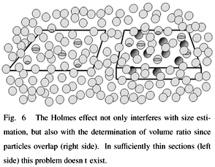
Size corrections
Holmes Effect – if objects small relative to section thickness
Shape Effect – mean ‘diameter’ for spheres, ellipsoids, cubes etc based on axial ratios or volume/surface ratios (complex, biased)

Slide 44
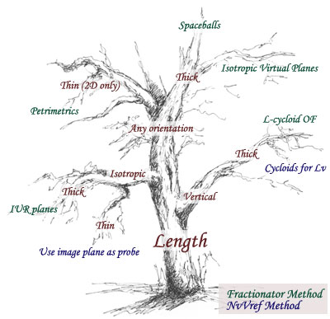
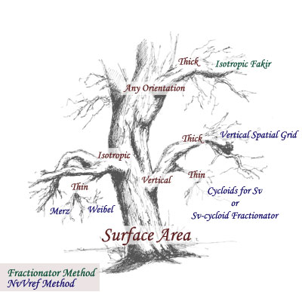
Stereology 2
How ?
New Design Based Stereology
Fractionator, Disector, Nucleator, Surfactor, Proportinator, Selector, Rotator, Cycloids
Surface Weighted Star Volume
Unbiased Brick, Isotropic Fakir
Spaceballs, Petrimetrics
Equipment / Design
Specialised Sampling; IUR, VUR, SRS sections
Thick sections, Optical sections
Unbiased Counting Frames
Gunderson, Sterio 1980s See Howard & Reed, 1998, 2010
www.stereology.info

Slide 45
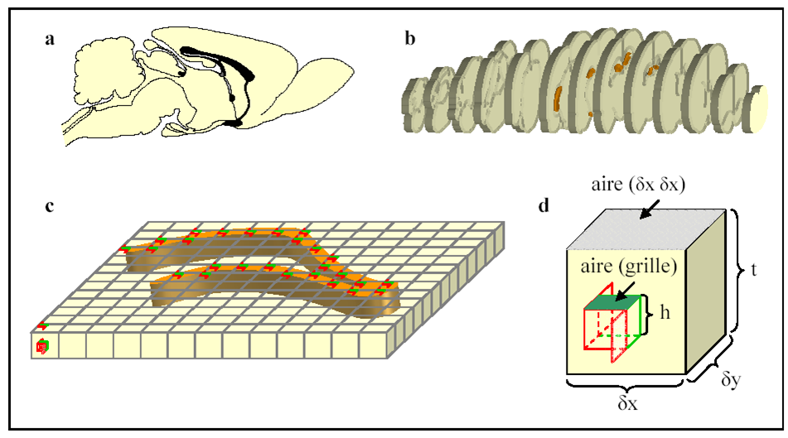
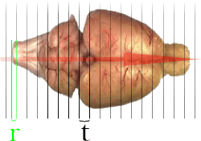
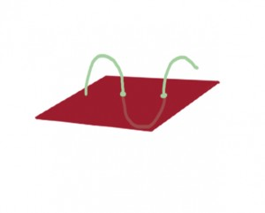
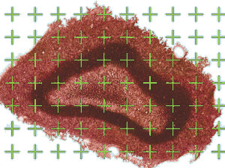
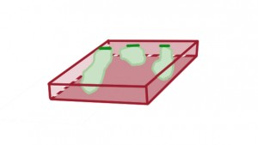
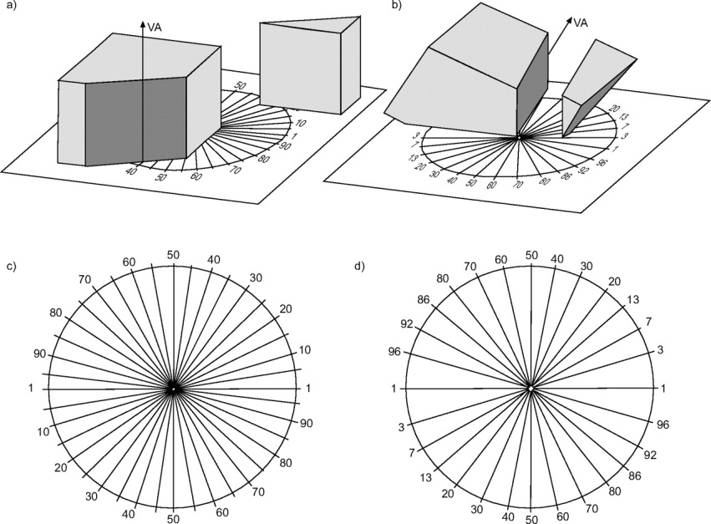
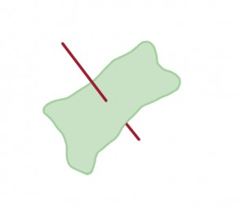
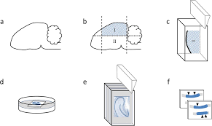
Cavalieri Method

Slide 46
Disector for counting
Total Number in a Volume
Oorschot, 2011

Slide 47
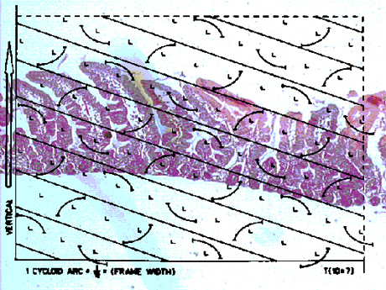
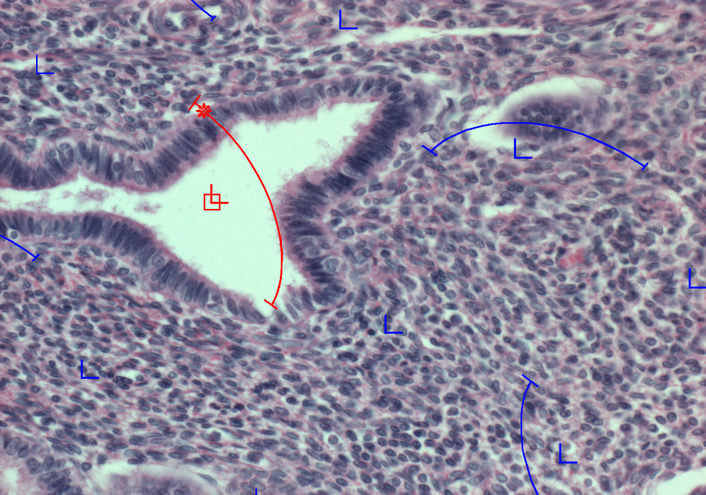
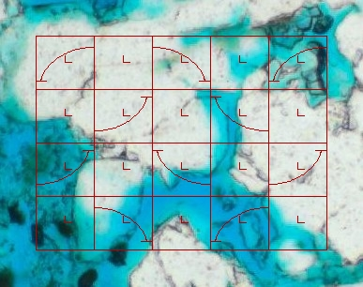
Cycloids for estimating Surface Area in a Volume

Slide 48
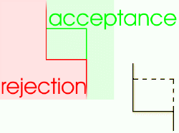
Unbiased Stereology
Measuring (see Picture 1) Since small objects are more likely to fit as complete objects within a measuring field it is best to remove this bias by measuring ALL objects within the frame and ALL objects hitting the dashed (allowed) lines but NOT those hitting the solid (forbidden) lines.
Counting (see Pictures 1 & 2) Objects allowed in the reference section (Picture 1 - A,B,C,D) are then checked in the next (look-up section (Picture 2)). If they DO NOT APPEAR in the look-up section these are the objects which are counted - ie object A ONLY. Therefore one object occupies a volume equal to the frame area times the section spacing. This is called the Disector Method.
See: Howard CV, Reed MG (1998) Unbiased Stereology. RMs Handbook 41; Bios Scientific.

Slide 49
Unbiased Counting Frame
B
D
A
E
C
Counting frame
F
Objects A,B, C, D only are counted
Forbidden lines
1) Reference Section

Slide 50
Disector method
B
D
A
E
C
F
2) Look-Up Section
Of the objects counted in the reference section (A,B,C,D) only the objects NOT present in the look-up section are counted, ie only object A is counted.

Slide 51
Mandarim-De-LaCerda (2003)

Slide 52
Recognition ?

Slide 54
Commercial Stereology Software Packages

Slide 55
Pattern Analysis Measurements of ‘Organisation’
How ?
Location / Distribution / Spatial Arrangement / Association / Connectivity / Interaction
???: Random, Regular, Clumped, Dispersed, Associated/Related
Distance: Nearest Neighbour, Mean free path
Grouping: Enclosed, Contiguity, Runs Test, SPAM
Autocorrelation
Tesselation / Joins / Overlay methods
Regional Density, Point Swarms
Orientation / Branching
Dendritic methods (fields, segments, nodes)
Isotropic, Anisotropic
See: Uylings, Berry, Aherne, Underwood, Johnson, Sokal & Rohlf, James, Mahon, Cruz-Orive, Diggle, Unwin

Slide 56
Examples

Slide 57
Nearest Neighbour Analysis
Developed from Ecology studies (Poisson distribution) Clark & Evans, 1954, Kendal & Moran, 1963
Average distance between objects or Mean area / cell
Begin at random cell / point Problems: reflexive pairs / high densities
Predict expected result for random population and compare
2D (eg muscle) d = 1/ (2 x sqrt NA)
3D (eg brain) d = 0.554/(cube rt Nv)
Index of Dispersion I_{d} = dobs/dexp
-
-
Also, Mean Free Path (edge-edge) James, 1977 λ = (1-Vv)/NL in μm

Slide 58
Homogeneity / Heterogeneity
Sampling :
avoid it
measure it

Slide 59
Randomness ?
Healthy Muscle
Diseased Muscle

Slide 60
Randomness ?

Slide 61
DISTRIBUTION
Enclosed “cell” method
Observed versus Expected
Predicted E= Np⁷ +/_ SD
Depends on percentage occurrence
30% R = 0 enclosed
50% R = 1
70% R = 8
90% R = 50
Johnson, 1973
X

Slide 62
DISTRIBUTION
Runs Test
RRRR W RRR WWWW R WW r = 6
R W R W R W R W R W R W R W R r = 15
N = 15, n1 R = 8, n2 W = 7
Exp F = [2 x (n1 x n2 / n1 + n2)] -1 = 6.5
T = (F - Exp F) / SD
Distribution IS Random
Distribution IS NOT Random
Predict Runs eg 100 cells 60% R = 47 +/-5 runs
Sokal & Rohlf, 1973

Slide 63
DISTRIBUTION
Run Lengths (Clumps) Roach, 1968
RRRR W RRR WWWW R WW Avlength R = 2.66
R W R W R W R W R W R W R W R Avlength R = 1.00
Predict expected run lengths ClR= N_{R} + PRL^{R-1} x (1-P_{R})²
for a random distribution ClW=N_{R} x P_{R} x (1=P_{R})^{LW}
100
Freq
%
50
0
10% R
50% R
0 1 2 3 4 5 6 7 8 9 ….
Run Lengths

Slide 64
DISTRIBUTION
Contiguity Underwood, 1970 Gurland, 1975 James, 1980
Apply test line and look at intersections with boundaries
Need to know length of test line and N_{RR} = R_R N_{WW} = W_W N_{WR} = W_R_W
Use stereological SV formulae modified for 2D
L_{A} = π/2 x P_{L}
Estimate Interface lengths for LA_{RR} LA_{WW} LA_{WR}
Index of Contiguity C_{RR} = LA_{RR}/(LA_{RR} + LA_{WR})

Slide 65
DISTRIBUTION
Spatial/Spiral Pattern Analysis of Muscle
Mahon, 1985

Slide 66
ASSOCIATION

Slide 67
Measure of Association – Circle Overlay Method
Cruz-Orive, 1976
eg: Eccentric nuclei, organelle clumping or autoradiography (Williams, 1977)
Problems: lattice size & spacing

Slide 68
Apply lattices and use mathematical concepts of “Lattice tesellation of congruent domains”
Tesselation

Slide 69
CONNECTIVITY
Brain Forest !

Slide 70
ORIENTATION
Apply line lattice

Slide 71
ORIENTATION

Slide 72
ORIENTATION
Sample/Probe it to – avoid it or measure it
II
Cut section in ONE plane
Apply line lattice in TWO orientations
Remember for Isotropic structures Sv = 2 x IL
T
Sv =π/2 I_{L} + 2I_{L} - π /2 I_{L}
T
II
II
Degree of orientation of surfaces
Ω = I_{L} + I_{L}
I_{L} + 4/ π I_{L} – I_{L}
T
II
T
II
II
NT James, 1980s

Slide 74
BRANCHING
Topology
Arbor or Tree analysis
Vertex / Branch / Segment
Bifurcations / tri .. / multi ..
Angles
Berry, 1980s

Slide 75
Artificial Intelligence (9th June 2014) Passed the Turing Test !

Slide 77
Mathematical Modelling of Topography & Development
Arthur

Slide 79
Movement
How ?
Organisms, cells, organelles
Subjective recording
Tracing
Direction
Velocity
Diffusivity
Association

Slide 80
Image Analysis
How ?
Automated/Computerised Measurement vs Eye/Brain
Early: 1969-1990 … then software based
MOP, Quantimet, Magiscan, Imagan, …. NIH Image-J, Matlab, LAS, Image Pro, i-Solution,
Procedure
Sampling
Calibration
Image capture
Segmentation
Thresholding, Edge Detection, Erosion/Dilation
Object detection
Measurement
Size, shape, number, density (IOD?), arrangement, …
Data analysis and display
+ / -
Speed & Measurement / Identification, User, Cost, GIGO

Slide 81
Thresholding
Segmentation

Slide 82
Edge Detection
Erosion / Dilation
Object Detection

Slide 83
Problems – brilliant results output But does the user know what the machine is doing and have they considered bias, caveats etc. ?? !!

Slide 84
GIGO
Results ?
Garbage In – Garbage Out !
“Garbage to ten decimal places is still garbage !”

Slide 85
Analytical Microscopy
How ?
Direction / Amplitude / Wavelength / Phase / Plane
Reflectance (Number)
Microdensitometry (Amount)
Fluorometry (Fluorescence)
Phase Contrast / Refractometry (Density)
Interferometry (Density, Thickness, Mass)
Polarisation / Polariometry (Orientation)

Slide 86
Microdensitometry 1
How ?
How much substance present?
Measure Areas, Volumes and Densities
Histochemistry (Specificity/Stoichiometry/Localisation/Section thickness/ …)
Bouger-Beer-Lambert Laws
Absorbance & Transmittance
Homogeneous Parallel Monochromatic Spot Light
Optical Density
Distribution Error
Integrated optical Density
Equipment: Flying-Spot microscope, M86, Magiscan 1930s, 1970s, now

Slide 87
Microdensitometry 2
How ?
How much substance present?
Beer: Concentration α Absorbance
Lambert: Absorbance = log₁₀ Incidence/Transmit
Concentration = g/cm³ or g/ area & thickness
Distribution Error: Uniform v Non-Uniform
T OD IOD (ArxOD)
50% 0.3 0.3
??% 30 & 0 0.3

Slide 88
Microdensitometry 3
Application
How much substance present?
Oxidative Enzyme distribution in a limb muscle ?
Red
Intermediate
Medial
Lateral
White
R= -0.90
P<0.001
Conc
Area

Slide 89
Why measure ?
What do you want to measure ?
How do we measure ?
Are the results unbiased, precise, accurate, valid, meaningful ?

Slide 90
Statistics !!!
Interpretation ?
Means
Arithmetic, Harmonic, Angular
Non-Parametric, Parametric
Gaussian
Poisson
Monte Carlo, Bose-Einstein, Autocorrelation
MANOVA, Hotelling test, Bonferroni
Data presentation
Binning, Linear, Areal, Percentages, …

Slide 91
Statistics !!!
Accuracy
Degree of closeness to true value
Precision
Related to reproducibility and repeatability
Improve by increasing sample size
Bias
Random or Systematic error
Valid
Measurement system which is ACCURATE and PRECISE and UNBIASED

Slide 92
Problems in Data Analysis
Means
Vv mito = meanPm/meanPt or mean of Pm/Pt
Circles
meanDia and calculate area or meanArea and calculate dia
A= π r²
Area
Freq
D
A
Diameter
Size

Slide 93
Allometry
The Bigger Picture ?
Relationship of size, shape, anatomy, physiology, behaviour
Snell (1892), D’Arcy Thompson (1917), Huxley (1932), Alexander (1970s), Weibel (1990s)
Scaling
Organelles, cells, organs, organisms, populations
Within species
Between species
See also Lecture …
Geometric Morphometrics (Frigot)

Slide 94
How to conduct a measurement project
Think
Do More
Less Well
Cheaply
Anywhere
Yourself
!!!

Slide 95
How to analyse a measurement project
What questions did they ask ?
How reliable is the visualisation of objects?
Did they sample correctly ?
Did they use a valid measurement tool ?
Did they measure precisely, accurately ?
Did they make any assumptions about shape, size, orientation etc ? Should they ?
Did they analyse/present the data correctly ?
Is their structural/functional/clinical reasoning valid?

Slide 96
… Caveat Emptor !

Slide 97
Mike’s motto ……
If it doesn’t move ……. Measure it !
If it moves ….. Measure its movement as well !!

Slide 99
http://www.lab.anhb.uwa.edu.au/mb140/scope/stereology/stereology.htm
http://www.scielo.br/scielo.php?script=sci_arttext&pid=S0001-37652003000400006

Slide 100
Question
What is the Answer to the Ultimate Question of Life, the Universe & Everything ?
= ??
Key Reference: Douglas Adams “Hitchhikers Guide to the Galaxy”

Slide 101
Example Course

